Slide 1



COMP3151 22T2
Assignment 2 Research
Szymanski Algorithm
A linear wait solution to solve the Lamport Concurrency Algorithm problem.
Jinghan Wang

Slide 2

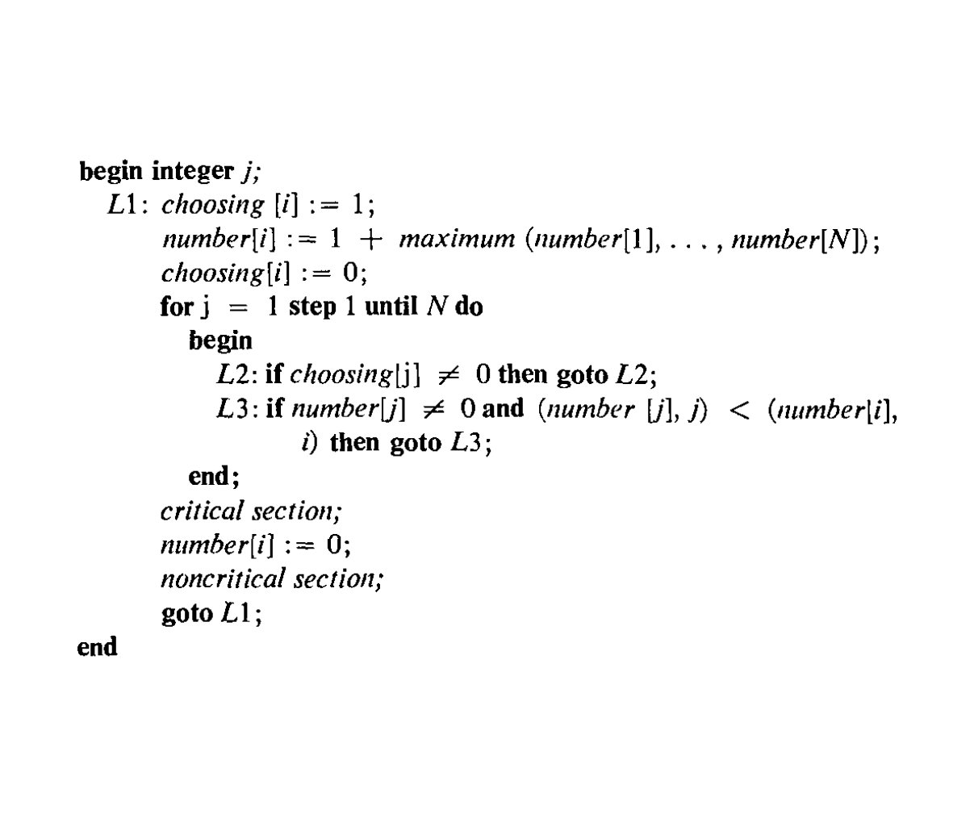

Lamport’s Bakery Algorithm
Unbounded size and number
Some drawback
Many shared variables are used
Unreliable that the failure of any of the processes stops progress

Slide 3
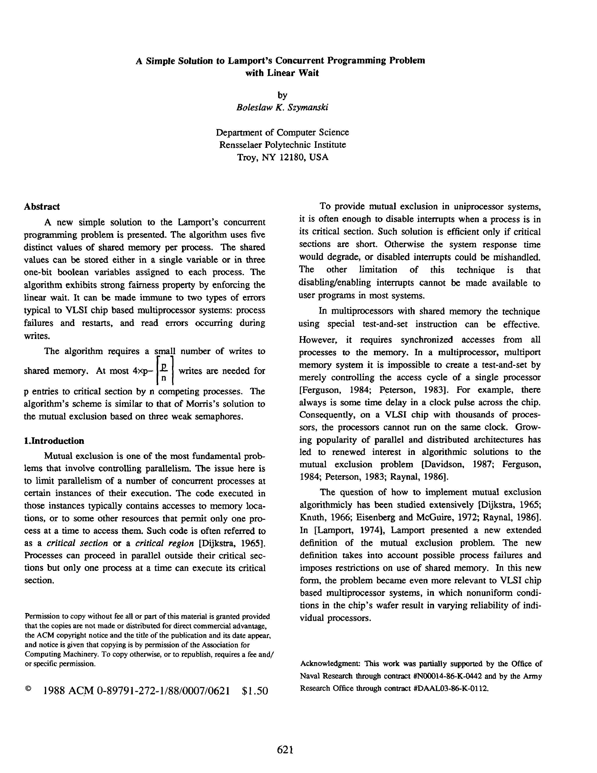
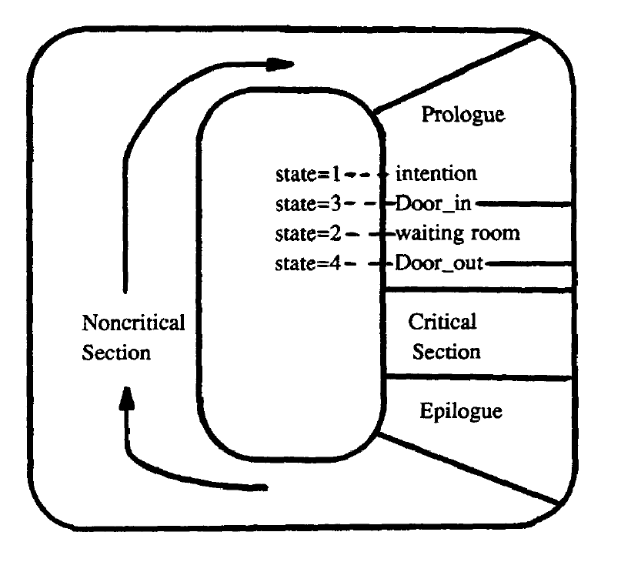
Szymanski Algorithm

Slide 4
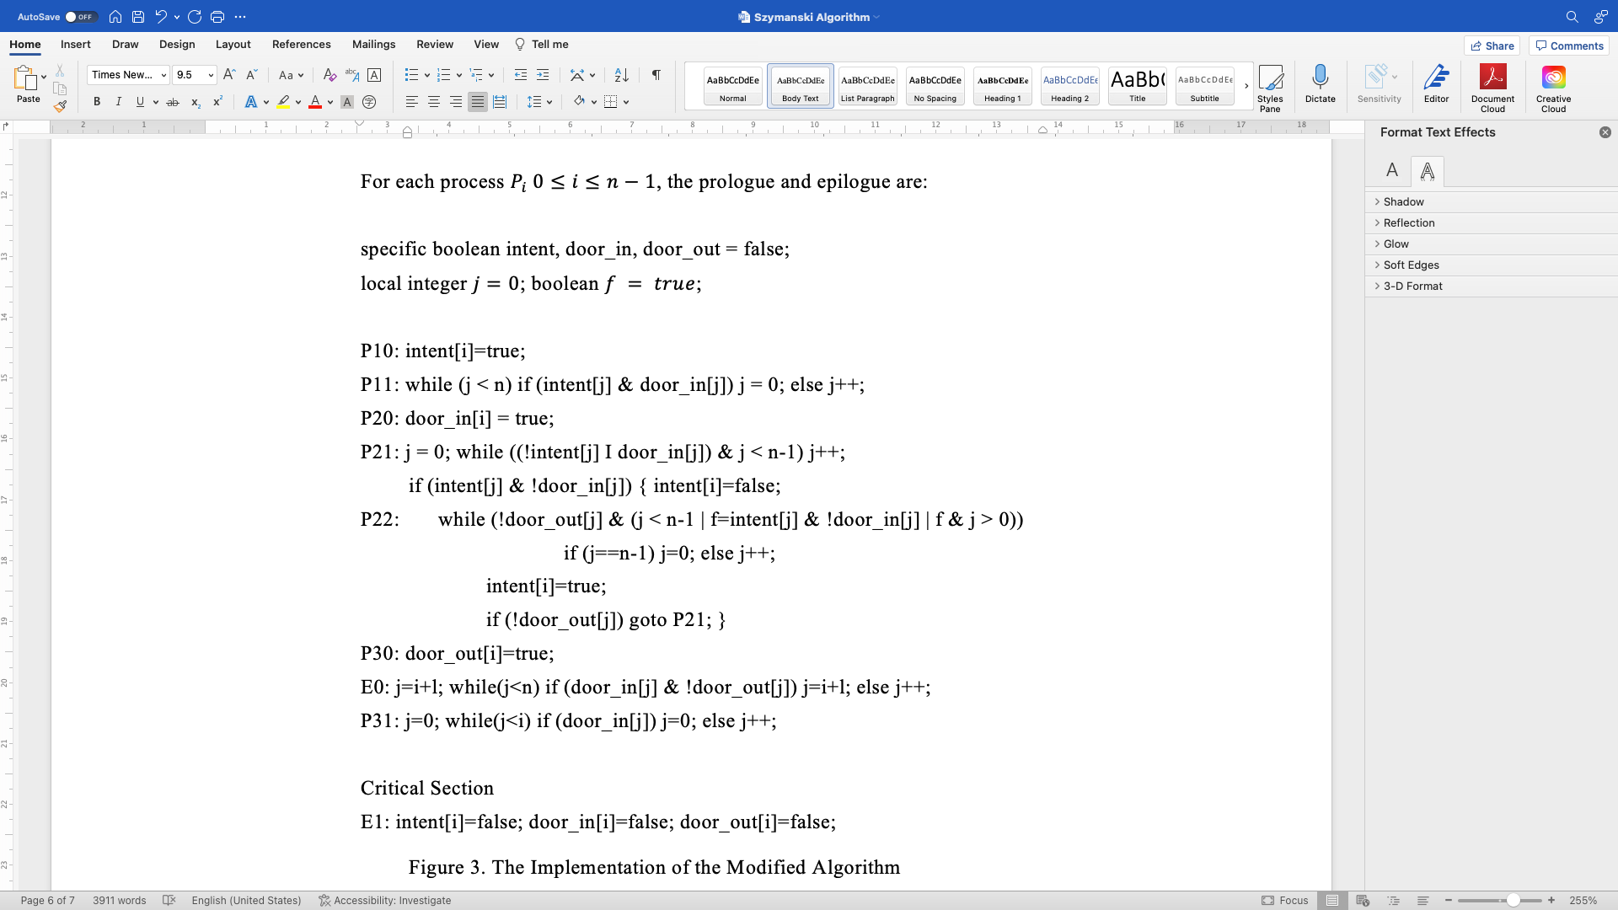
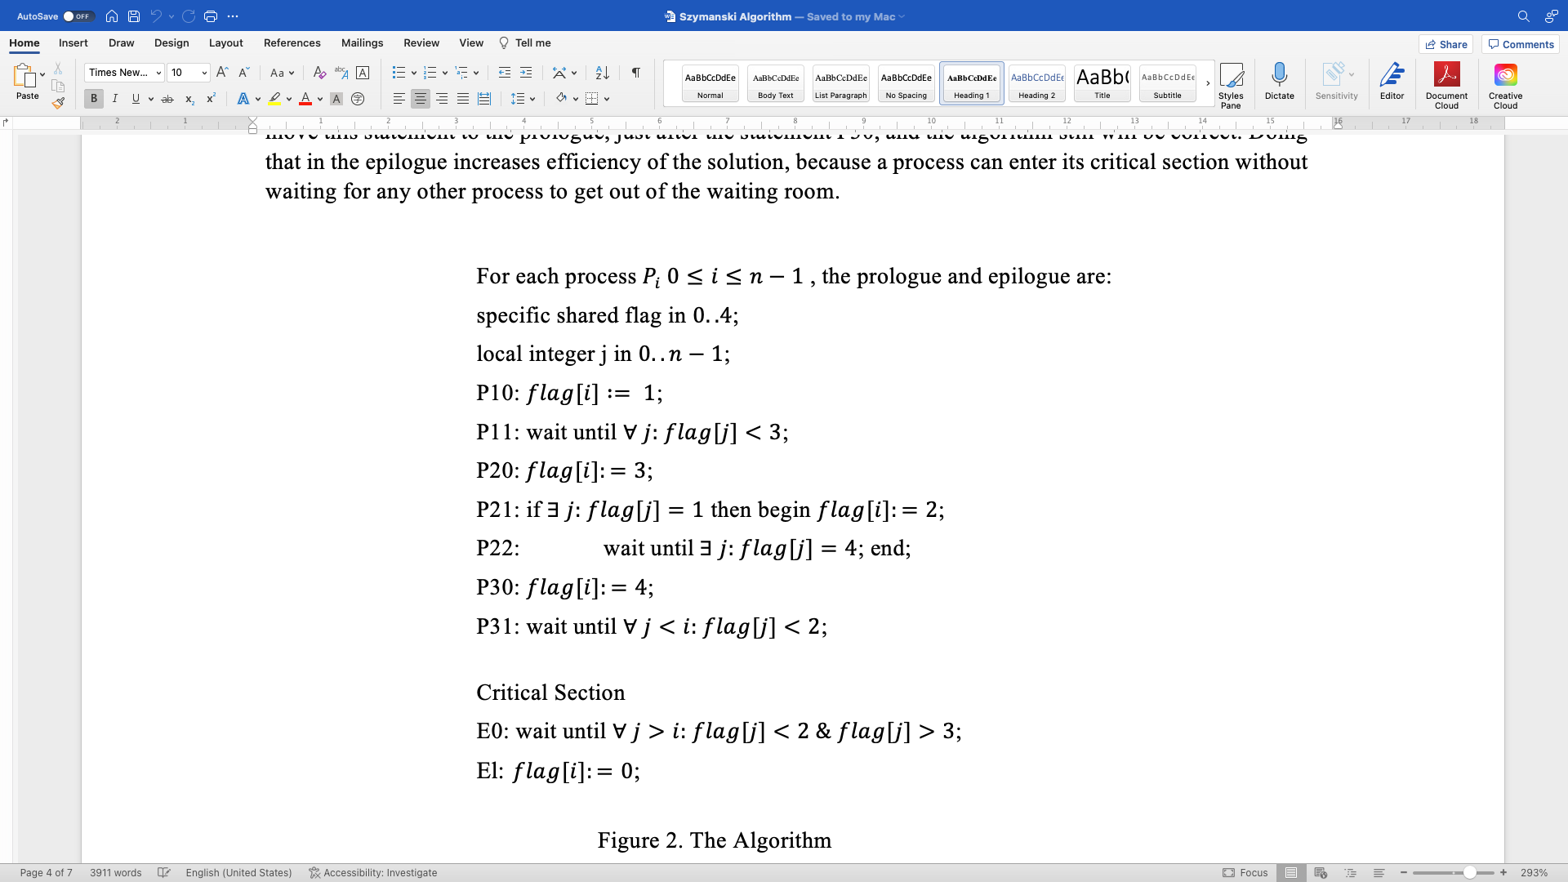
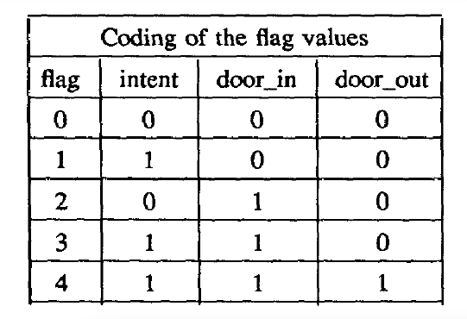
Szymanski Algorithm
Only use five distinct values
Use three boolean variables

Slide 5
Szymanski Algorithm
Process have not start
Flag = 0
Denoting that the owner process is in the noncritical section
Process exit CS and return to non-CS

Slide 6
Szymanski Algorithm
Process want
to entry CS, check whether Door_in is open.
Flag = 1
indicating that the owner process wants to enter its critical section (declaration of intention),

Slide 7
Szymanski Algorithm
indicating that the owner process wants to enter its critical section (declaration of intention)
Flag = 2
Process in waiting room, open Door_in and let other flag =1 process come in to waiting room.
Wait all flag = 1 process arrive and go into CS

Slide 8
Szymanski Algorithm
denoting that the owner process has just passed through the door_in
Flag = 3
Close Door_in and check.
If exist flag = 1 process, go to waiting room, change flag = 2 to open Door_in
If not, keep Door_in close, change flag = 4, open Door_out.

Slide 9
Szymanski Algorithm
indicating that the owner process has crossed the door_out
Flag = 4
Open Door_out, all process in waiting room Line up to entry to CS

Slide 10
Implementation problem
Travel the array,
Time complexity is O(n),
After we check the value, we cannot ensure that whether the value is original

Slide 11
Implementation with Java 11

Slide 12
Szymanski Algorithm Proof
The algorithm preserves mutual exclusion.
When flag[j] = 4, the P11 be blocked, No process can enter waiting room , until all waiting room process exit from CS.
For process i want to enter critical section:
Flag [i] = 4,
For all process j < i, flag [j] <= 1. If else, wait until the flag [i] = 0 or flag [i] = 1

Slide 13
Szymanski Algorithm Proof
The algorithm preserves mutual exclusion.
The algorithm prevents deadlock.
1 | 2 | 3 | 4

Slide 14
Szymanski Algorithm Proof
The algorithm preserves mutual exclusion.
The algorithm prevents deadlock.
1 | 2 | 3 | 4

Slide 15
Szymanski Algorithm Proof
The algorithm preserves mutual exclusion.
The algorithm prevents deadlock.
1 | 2 | 3 | 4

Slide 16
Szymanski Algorithm Proof
The algorithm preserves mutual exclusion.
The algorithm prevents deadlock.
1 | 2 | 3 | 4

Slide 17
Szymanski Algorithm Proof
The algorithm preserves mutual exclusion.
The algorithm prevents deadlock.
The algorithm exhibits linear wait property.

Slide 18

Thanks for Watching!
The research exists some insufficient, I am looking forward professor to pointing out!

